Slide 1
Socio-economical factors affecting Student Performance
Bayesian Network and causality inferences
Suzanne Chung
CKME 136

Slide 2
What affects students’ academic performance?
Issue
Students’ performance
What is it driven by?
Family history (educational, support, job)
School involvement (ie. extra curricular activities, attending extra classes, paid tutoring etc.)
Personal (ie. alcohol consumption, relationship, study habits, educational history)
Problem
Can we identify what affects students’ performance?

Slide 3
Dataset
UCI Machine Learning Repository, which can be found here: https://archive.ics.uci.edu/ml/datasets/Student+Performance
Two datasets
Math Class
Portuguese Class
33 attributes
Demographics
School engagement/involvement
Personal

Slide 4
Approach
Data Preparation
Exploratory Data Analysis: Plots, Regression, Correlation - Preliminary Analysis
Finding the optimal model
Bayesian Network and Causality Inferences

Slide 5
Data Preparation and Exploratory Analysis
Data Preparation
Combined both Math and Portuguese dataset
Exploratory Analysis
Students’ commitment to study related to students’ past failures?
Family support relative to Parents’ educational history
Linear Regression
Age
Family Relationship
Absences
G1 and G2 (progress grades)

Slide 6
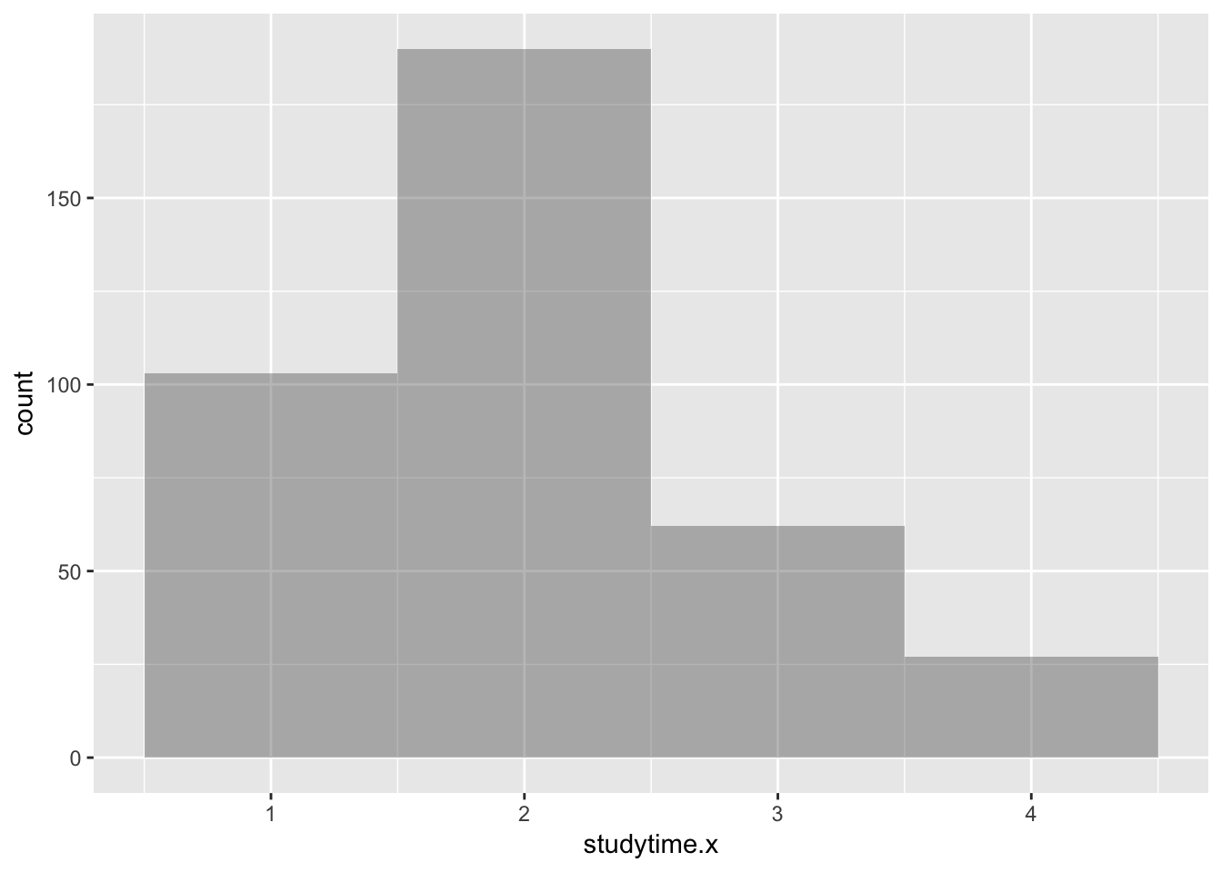
Graph Results

Slide 7
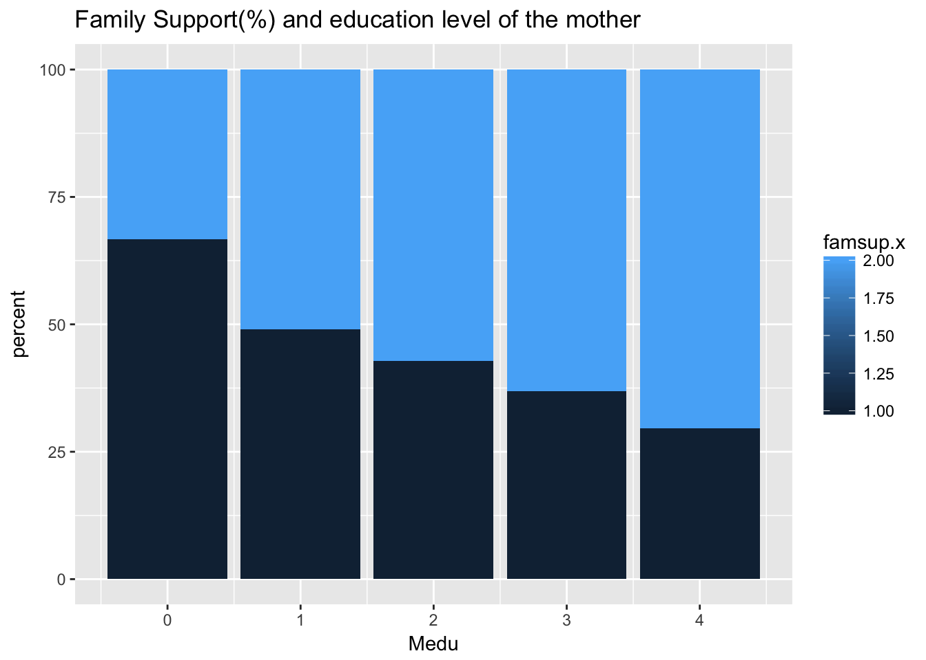
Graph Results

Slide 8
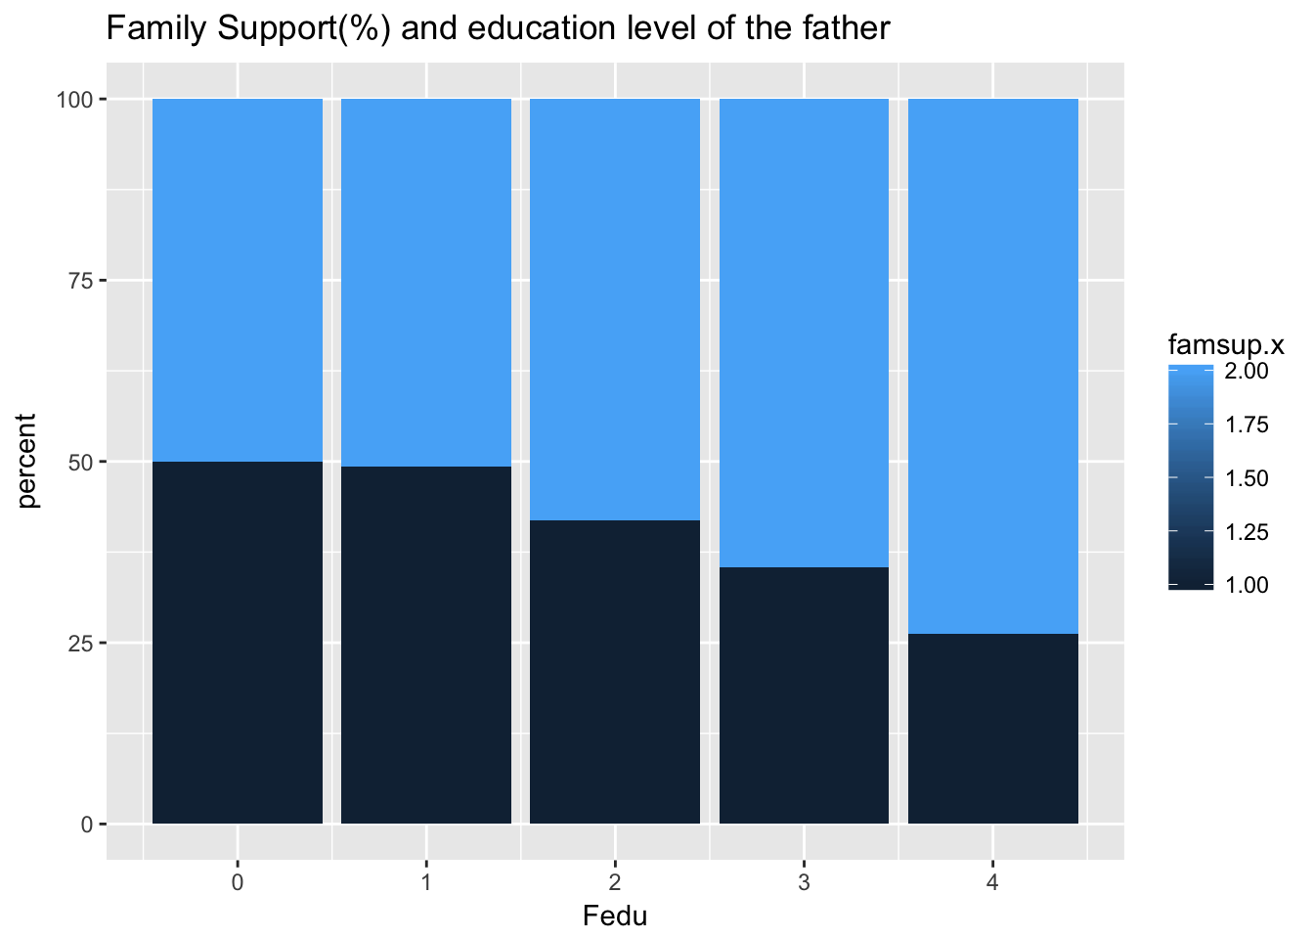
Graph Results

Slide 9
Finding the optimal model
Which attributes are important?
Feature Selection
School Support
Age
Higher
Failures
G1
G3 (Final Grade) - Outcome
Guardian
Absences
Romantic
Activities

Slide 10
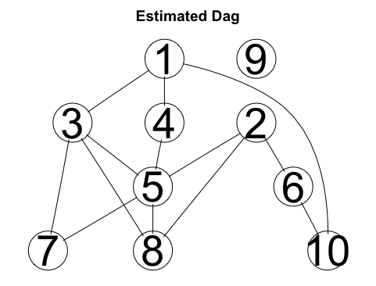
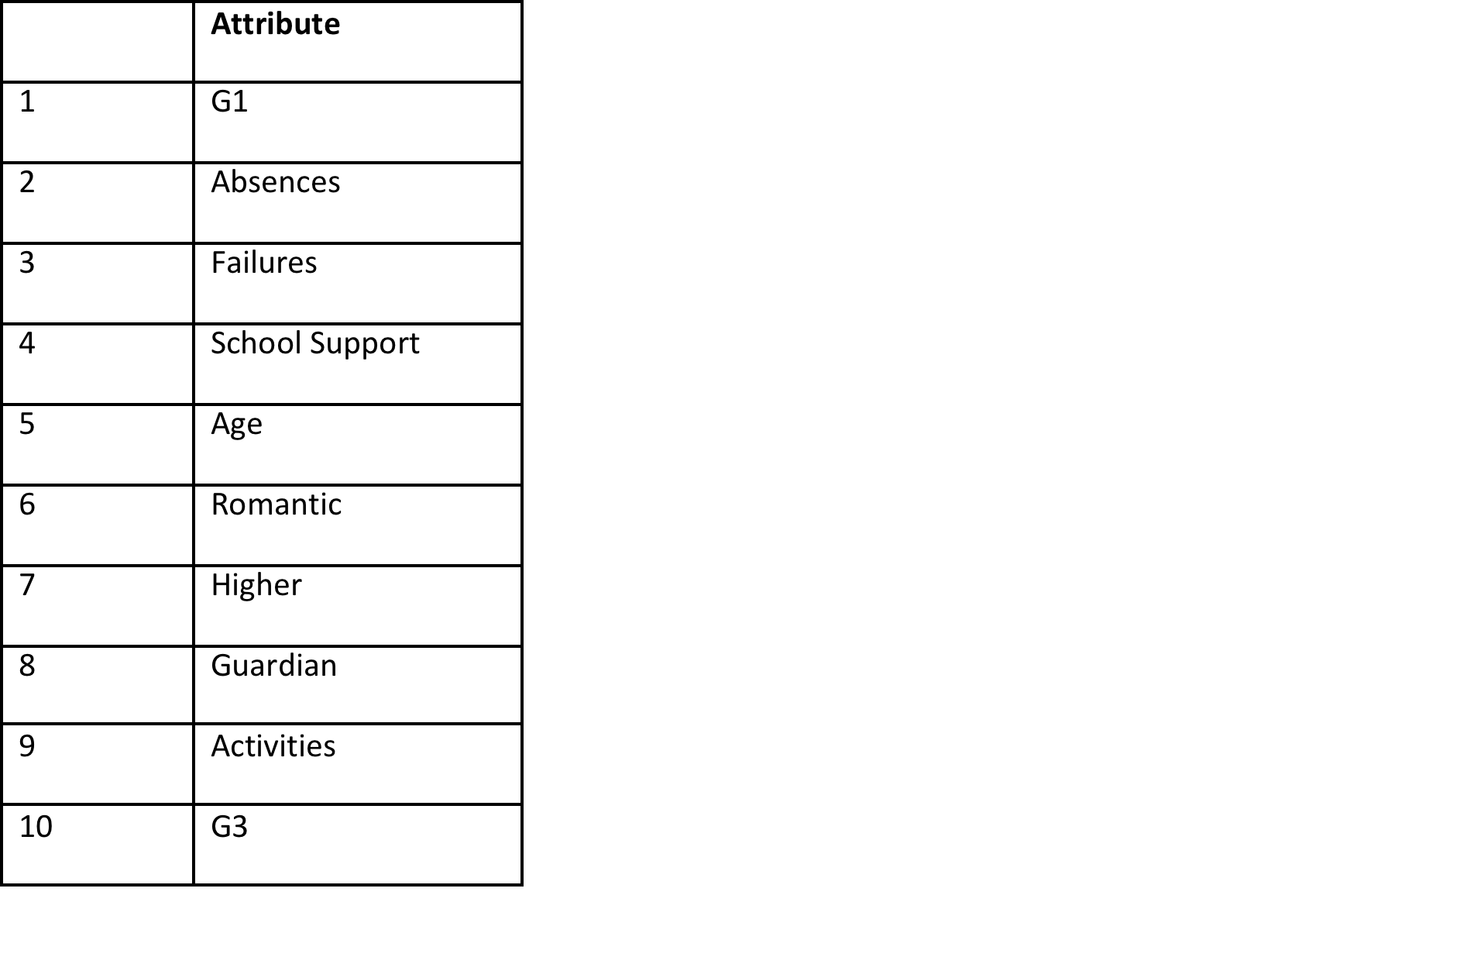
Causality Inferences

Slide 11
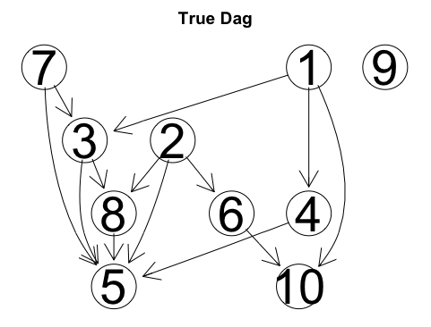
Causality Inferences

Slide 12
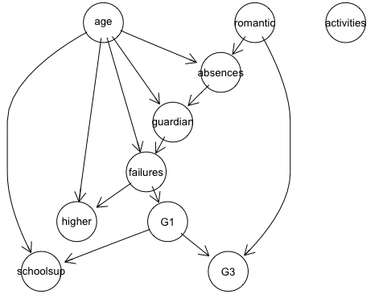
Bayesian Network

Slide 13
Conclusion
Results
Romantic and G1 main causes
Improvements
More students to survey
Attributes can be condensed or clear
Eg. weekday vs weekend alcohol consumption
Parents’ job could be summed up as household income

